Slide 1

Food Recipe Application
Under The Guidance Of
Dr.C.M.SUJA
By
TATA HEMANTH VENKAT
(41111262)

Slide 2
ABSTRACT
The Food Recipe Application is a robust web-based platform that offers a delightful culinary experience by combining HTTP for data handling, CSS for stunning user interface design, and Java for dynamic functionality.Key features of this application include:
1. *Recipe Database*: Utilizing HTTP requests, the application communicates with a backend server to retrieve an extensive database of recipes. Users can search, filter, and sort recipes based on various criteria, including ingredients, cuisine, and dietary preferences.
2. *User Authentication and Profiles*: Java is employed to implement user registration, authentication, and profile management. Users can create accounts, save their favorite recipes, and personalize their profiles.
3. *Recipe Details*: When users select a recipe, Java-driven functionality provides detailed instructions, ingredients, nutritional data, and user reviews. CSS styles ensure that this information is presented in an aesthetically pleasing and user-friendly manner.
4. *Recipe Submission*: Registered users can upload their recipes, and Java-driven forms ensure that the data is collected efficiently. CSS styles enhance the presentation of submitted recipes, making them visually appealing.
5.*Responsive Design*: CSS media queries are employed to create a responsive design that adapts to various screen sizes and devices, offering an optimal viewing experience.
6.*Interactivity*: Java enhances the user experience by adding interactive features such as real-time search suggestions, dynamic loading of recipe results, and user-generated content management.
7. *Social Integration*: Users can easily share their favorite recipes on social media platforms, increasing the application's reach and engagement . By incorporating HTTP for data retrieval, CSS for stunning visual design, and Java for dynamic functionality, the Food Recipe Application offers users an engaging, informative, and user-friendly culinary experience, ensuring that cooking enthusiasts can explore, create, and share their favorite recipes with ease.

Slide 3
INTRODUCTION
A mobile app or most commonly known simply as an app refers to an application software that is created to be run on a mobile device such as, smartphone or tablets. Mobile apps can have many different types. Some of these types include music apps, ride sharing apps, food recipe apps, online store apps, and video games. Depending on the app it might need to be connected to the internet to work properly or it might be fully functional offline. The programming language that is used to develop a mobile differs based on the operating system that the app is going to work on. For example, apps running on an android phone are mostly written in Java, while apps running on iOS phones are written in Objective C or Swift. When creating an online app (mobile or web apps), the developers usually use databases. Merriam-Webster defines database as following, “a usually large collection of data organized especially for rapid search and retrieval (as by a computer)
[1].” Online databases are used to save different types of data which can be later updated or retrieved by different devices using the internet. This allows devices to access the information on the database from anywhere with internet access. Databases can be accessed directly or through a web-service. Web-service refers to an application or data source that accessible through standard web protocols. The important aspect of web-services is that they are designed to communicate with other programs instead of directly doing so with the user. The main benefit of using a webservice to connect to a database is that usually a web-service can communicate any application, no matter where the application resides. For example, connection to a web service can be implemented on an Android app, while also using the web-service on an iOS app, without the need to recode the web-service or the app. The architecture used to create web-services is the Client/Server architecture. According to Technopedia a Client/Server architecture is “a computing model in which the server hosts, delivers and manages most of the resources and services to be consumed by the client. This type of architecture has one or more client computers connected to a central server over a network or internet connection. This system shares computing resources.” When using this architecture, a client sends a request to the web-service that transfers that request to the database. Once the request is processed, the processed data is sent back to client through the web-service. This project uses both databases and web-services to design and implement an online food recipe Android app. The app is intended to have an intuitive and simple user interface that allows the user to find and view different food recipes based on different inputs such as, the type of food, the cuisine, and the food course. The user can then filter the list of recipes based on the ingredients used in the recipe, as well as the serving size and the time it takes to make the food. He or she can then look at the information for the desired recipe by choosing that recipe from the provided list. In addition, the user can add his or her own recipes to the database.

Slide 4
OBJECTIVE
User-Friendly Interface: Create an intuitive and user-friendly interface that allows users of all ages and technical abilities to navigate the application easily.
Vast Recipe Database: Build a comprehensive database of recipes covering various cuisines, dietary preferences (e.g., vegetarian, vegan, gluten-free), and cooking skill levels (beginner to advanced).
Search and Filter Functionality: Implement robust search and filter options, enabling users to find recipes based on ingredients, cuisine, dietary restrictions, preparation time, and more.
Personalized Recommendations: Develop an algorithm that provides personalized recipe recommendations to users based on their past searches and saved recipes.
Recipe Details: Display detailed recipe information, including ingredients, step-by-step instructions, cooking tips, and nutritional facts.
Ingredient Management: Allow users to create shopping lists based on selected recipes and offer the option to check off ingredients as they shop.
Meal Planning: Integrate meal planning features, enabling users to create weekly or monthly meal plans, complete with recipes and shopping lists.
Recipe Ratings and Reviews: Allow users to rate and review recipes, fostering a sense of community and helping others choose tried-and-tested recipes.
User Profile: Enable users to create profiles where they can save their favorite recipes, view their cooking history, and customize their dietary preferences.
Cooking Timers and Conversions: Include timers for different cooking steps and a unit conversion tool for easy recipe adaptation.
Interactive Cooking Mode: Implement a hands-free cooking mode with voice commands or step-by-step visual guides for cooking.

Slide 5
OBJECTIVE
Offline Access: Ensure that users can access their saved recipes and shopping lists offline for convenience in the kitchen.
Ingredient Substitutions: Offer suggestions for ingredient substitutions to accommodate dietary restrictions or ingredient availability.
Social Sharing: Allow users to share their favorite recipes on social media platforms and with friends and family.
Allergen Alerts: Implement allergy alerts, notifying users if a recipe contains ingredients they are allergic to.
Community and User-Generated Content: Encourage users to contribute their own recipes, photos, and cooking tips to build a thriving community within the app.
Regular Updates: Continuously update the recipe database, fix bugs, and add new features to keep the app fresh and engaging.
Cross-Platform Accessibility: Ensure the application is accessible on various devices, including smartphones, tablets, and desktop computers.
Monetization Strategy: Develop a sustainable monetization strategy, such as premium subscriptions, ads, or in-app purchases, while maintaining a free basic version

Slide 6
EXISTING SYSTEM
User Registration and Profiles: Users can create accounts, set up profiles, and manage their preferences. This allows for personalized experiences and features like saving favorite recipes.
Recipe Search: Users can search for recipes based on various criteria such as cuisine, ingredients, dietary restrictions, and cooking time.
Recipe Display: Detailed recipe pages that include ingredients, preparation steps, cooking tips, nutritional information, and user reviews.
Meal Planning: Some applications offer meal planning tools, allowing users to create weekly meal plans and generate shopping lists.Shopping Lists: Users can add ingredients from recipes to a shopping list, making it easier to plan and organize their grocery shopping.
Dietary Filters: Users can filter recipes based on dietary preferences and restrictions, such as vegetarian, vegan, gluten-free, or keto.
Recipe Ratings and Reviews: Users can rate recipes and leave reviews, which can help others decide if they want to try a particular dish.

Slide 7
PROPOSED SYSTEM
The proposed system for a food recipe application aims to provide an easy-to-use and comprehensive platform for users to discover and access a wide range of food recipes. The system is designed to be accessible via a mobile application and a web portal, making it convenient for users to access the platform from anywhere.
The proposed system is equipped with various features that make it easier for users to search for their favorite recipes. The system will have a search function that enables users to filter recipes by ingredients, cuisine type, cooking time, and other relevant parameters. Additionally, the system will provide a recommendations feature for users, which suggests new recipes that they might enjoy based on their previous searches.
The food recipe application will feature a user-friendly interface that is easy to navigate. The system will include high-quality images of the dishes, offering users a visual representation of the recipe. Moreover, the application will include step-by-step instructions, how-to videos, and nutritional information about each recipe to give users a complete overview of the dish.

Slide 8
APPLICATION
Cooking Inspiration: Users can browse through a diverse range of recipes to find inspiration for their next meal, whether it's for everyday cooking or special occasions.
Meal Planning: The app allows users to plan their meals by selecting recipes for the week or month, helping them organize their grocery shopping and cooking schedule.
Dietary Management: Individuals with specific dietary preferences or restrictions, such as vegetarians, vegans, or those with food allergies, can easily find recipes tailored to their needs.
Health and Nutrition: Users can access nutritional information for recipes, helping them make informed choices about their diet and health.
Grocery Shopping: The app generates shopping lists based on selected recipes, making it convenient for users to shop for the ingredients they need.
Cooking Tips and Techniques: Users can learn new cooking techniques, tips, and tricks from the detailed instructions provided with each recipe.
Ingredient Substitutions: In cases where users don't have certain ingredients on hand, the app can suggest suitable substitutions.
Cooking Challenges: Some apps offer cooking challenges or contests, encouraging users to try new recipes and share their creations with the community.
Interactive Cooking Guides: Advanced apps may offer interactive cooking guides with step-by-step instructions, cooking timers, and voice commands for a hands-free cooking experience.
Social Sharing: Users can share their culinary creations and achievements on social media platforms, fostering a sense of community and inspiration among fellow food enthusiasts.

Slide 9
SOFTWARE AND HARDWARE REQUIREMENTS
Hardware:
Smartphone or Tablet: Users need a compatible device running iOS or Android.
Processor: The device should have a sufficient processor to handle the app's functions smoothly.
Memory (RAM): At least 2GB of RAM is recommended for optimal performance.
Storage: The app itself may require anywhere from 50MB to 200MB of storage space, but users will also need space to store recipes, images, and other data.
software:
Operating System: Compatibility with current and recent versions of iOS and Android.
Development Tools: Depending on the platform, you'll need Xcode for iOS development (Swift or Objective-C) and Android Studio for Android development (Java or Kotlin).
Backend Server: If your app requires user accounts, synchronization, or social features, you'll need a server with appropriate software and APIs.
Database: You may need a database system (e.g., MySQL, MongoDB) to store user profiles, recipes, and other data.APIs: Access to APIs for features like ingredient information, nutrition data, and weather (if relevant to cooking plans).
Cloud Storage: For storing images, recipes, and user data, you may use cloud storage services like AWS S3 or Firebase Storage.

Slide 10
SYSTEM ARCHITECTURE
Start
Open the app
Select Recipe
Recipe not found
Recipe found
Recipe description
end

Slide 11

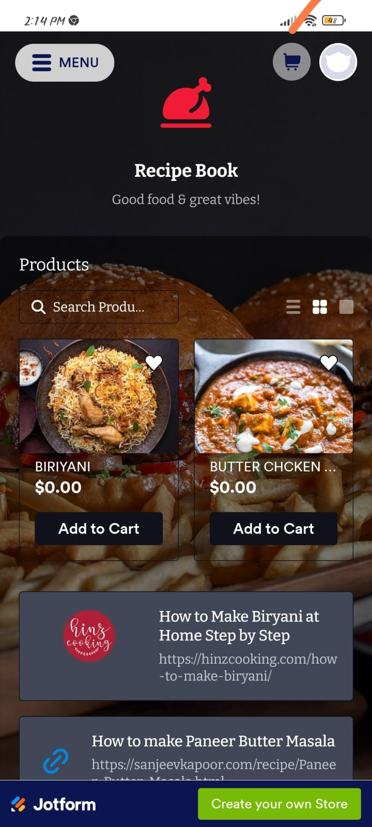
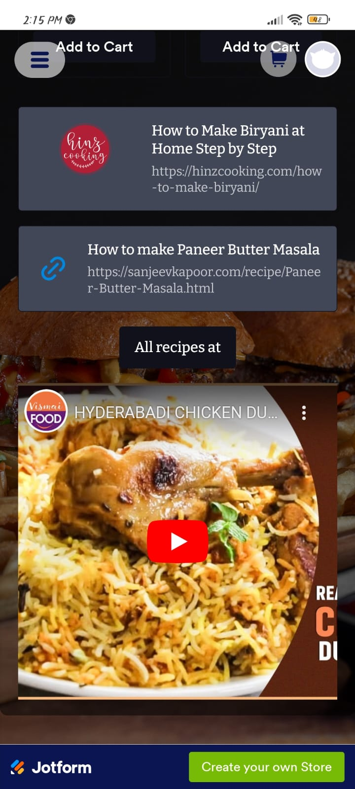
MODULES

Slide 12
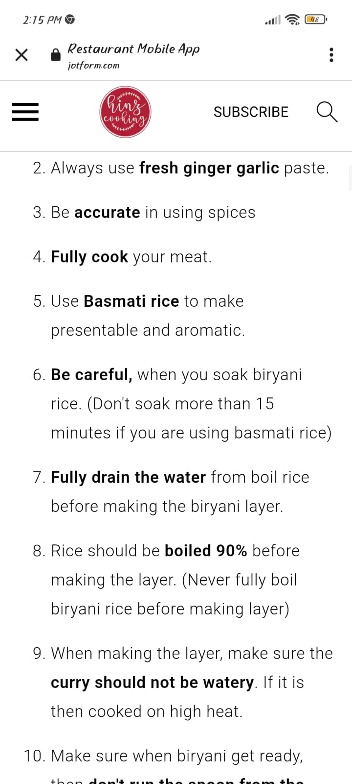
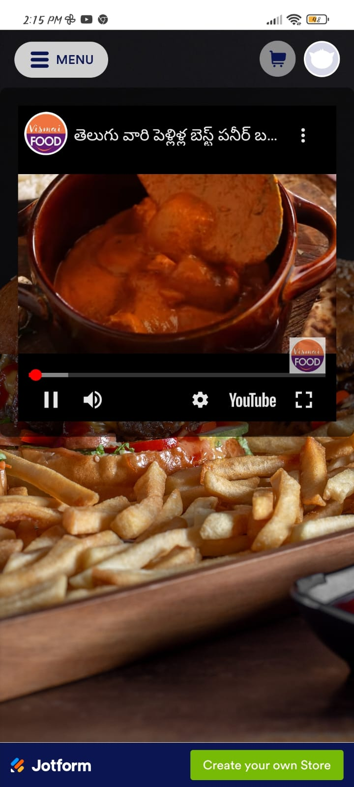
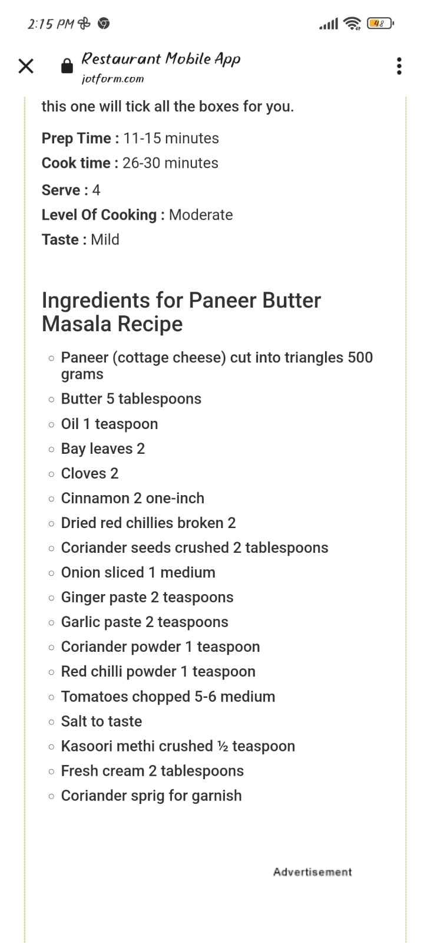
MODULES

Slide 13
CONCLUSION
In conclusion, a food recipe application offers a delightful and practical solution for individuals passionate about cooking and culinary exploration. This versatile application combines technology with the art of cooking, providing users with a wide array of benefits and features.
With a user-friendly interface and an extensive recipe database, users can easily find culinary inspiration, plan their meals, and discover new flavors. The application's search and filtering functionalities empower users to tailor their cooking experience to their dietary preferences, available ingredients, and culinary skill level.
Personalization features, such as recommendation engines and user profiles, enhance the user experience by offering tailored recipe suggestions and the ability to save favorite dishes. The application also aids in meal planning and grocery shopping, simplifying the entire cooking process.
Furthermore, food recipe applications foster a sense of community by enabling users to share their culinary creations, reviews, and cooking tips. Users can connect with like-minded individuals, making the app not only a valuable tool but also a platform for culinary enthusiasts to connect and share their passion.
Security measures ensure the protection of user data, while analytics and monitoring tools continuously improve the application's performance and user experience. Additionally, monetization strategies, such as premium subscriptions and in-app purchases, can make the application sustainable while maintaining a free basic version for wider accessibility.
Overall, a well-designed food recipe application enriches the culinary journey, promotes healthy eating habits, reduces food waste, and brings people together over the shared love of food. Whether you're a novice cook looking for guidance or a seasoned chef seeking culinary inspiration, a food recipe application has something to offer for everyone, making it a valuable and enjoyable addition to the modern kitchen.

Slide 14
REFERENCES
[1] Merriam-Webster. Database | Definition of Database by Merriam-Webster. Retrieved May 4, 2018 from https://www.merriam-webster.com/dictionary/database.
[2]Firebase. Firebase Products. Retrieved May 4, 2018 from https://firebase.google.com/products/.
[3] Katherine Chou, Xavier Ducrohet, Tor Norbye. 2013. Android Developers Blog: Android Studio: An IDE built for Android. Retrieved May 5, 2018 from https://androiddevelopers.googleblog.com/2013/05/android-studio-ide-built-for-android.html.
[4] Android Developers. Android Studio Features | Android Developers. Retrieved May 5, 2018 from https://developer.android.com/studio/features/.
[5] Jon Byous. 1999. JAVA TECHNOLOGY: THE EARLY YEARS. Internet Archive, Retrieved May 6,2018fromhttps://web.archive.org/web/20050420081440/http://java.sun.com/features/1998/05/birth day.html.

Slide 15

Thank you

